Slide 1
Huffman codes for compressing messages
A Huffman code is an optimal uniquely decodable (UD) code. This means two things:
You can decode a message by looking at each incoming character in sequence. At each step either the characters you have seen do not yet correspond to any letter, or they correspond to exactly one.
The encoded message is the shortest possible one among all encoding schemes that have property (1).
*
1

Slide 2
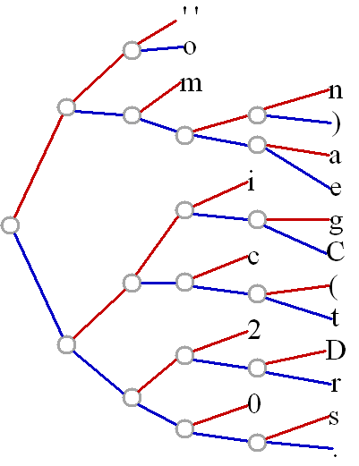
to encode the message: "(C) 2002 Directionsmag.com".
Character
Frequency
Code
Tree (see below)
' '
2
000
'('
1
10110
')'
1
01101
'.'
1
11111
'0'
2
1110
'2'
2
1100
'C'
1
10011
'D'
1
11010
'a'
1
01110
'c'
2
1010
'e'
1
01111
'g'
1
10010
'i'
2
1000
'm'
2
010
'n'
1
01100
'o'
2
001
'r'
1
11011
's'
1
11110
't'
1
10111
*
2

Slide 3
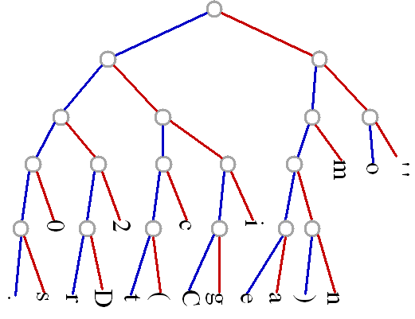
Huffman tree for the message: "(C) 2002 Directionsmag.com".
*
3

Slide 4
Compression with Huffman codes
The encoded message is: 10110 10011 01101 000 1100 1110 1110 1100 000 11010 1000 11011 01111 1010 10111 1000 001 01100 11110 010 01110 10010 11111 1010 001 010.
Its length is 110 bits, or about 4.24 bits per character.
The original ASCII representation required eight bits per character, totaling 208 bits.
The compression is almost 50%.
*
4

Slide 5
Basic principle used in Huffman codes
Characters that appear more frequently are assigned shorter codes.
In order for a string to be uniquely decodable, there must be no ambiguity in the decoding.
Thus, the code for one character must never be the start of a code for another.
For instance, assigning "000" to the space character meant that no other code could begin with "000".
*
5

Slide 6
Construction of Huffman codes
The letters with the two smallest frequencies are located, combined as leaves at a node, and then that node is treated as if it were a letter having the combined frequencies of its two leaves.
The process is repeated until all letters have been put into the tree
*
6

Slide 7
Huffman code construction algorithm
The algorithm requires one to find the smallest frequency in a potentially long list for each step.
Add the two smallest end and insert each combined frequency back into the list.
*
7

Slide 8
Huffman code- Algorithm Example
To encode the letters A (0.12), E (0.42), I (0.09), O (0.30), U (0.07), listed with their respective probabilities.
Go through the following steps:
*
8

Slide 9
Huffman code- Algorithm
Consider each of the letters as a symbol with its respective probability.
Find the two symbols with the smallest probability and combine them into a new symbol with both letters by adding the probabilities.
Repeat step 2 until there is only one symbol left with a probability of 1.
*
9

Slide 10
Huffman code- Algorithm
To see the code, redraw all the symbols in the form of a tree, where each symbol contains either a single letter or splits up into two smaller symbols.
Label all the left branches of the tree with a 0 and all the right branches with a 1.
The code for each of the letters is the sequence of 0's and 1's that lead to it on the tree, starting from the symbol with a probability of 1.
*
10

Slide 11
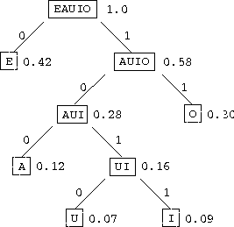
Huffmantree for A (0.12), E (0.42), I (0.09), O (0.30), U (0.07),
*
11

Slide 12
Huffman Codes for letters and strings
Thus the codes for each letter are: A – 100, E – 0,
I - 1011 , O - 11 , U - 1010
Now using this code, any string of vowels can be written uniquely.
AI = 1001011
EIEIO = 010110101111
UEA = 10100100
IE=10110
AUO =100101011
EIOOU= 0101111111010 =
*
12

Slide 13
Exercises
1.Create Huffman trees and codes for the following sets of letters with the given probabilities:
A (0.20), B (0.09), C (0.15), D (0.11), E (0.40), F (0.05)
A (0.05), C (0.04), E (0.16), G (0.02), I (0.04), L (0.07), M (0.09), N (0.08), O (0.12), R (0.08), S (0.09), T (0.10), U (0.04), Y (0.02)
A (0.04), B (0.02), C (0.03), D (0.03), E (0.13), F (0.01), G (0.02), H (0.02), I (0.03), J (0.01), K (0.02), L (0.06), M (0.07), N (0.06), O (0.10), P (0.02), Q (0.01), R (0.06), S (0.07), T (0.08), U (0.03), V (0.02), W (0.02), X (0.01), Y (0.02), Z (0.01)
*
13

Slide 14
Exercises..
For the codes you created, try encoding some words and have a friend decode them.
The following character counts were obtained from a document: D (894), E (3320), F (698), M (661), O (1749), R (1600). Create a Huffman tree and code for these characters and encode the word 'freedom'.
Write a computer program which will input characters and their frequencies, create a Huffman code, and encode and decode strings.
*
14

Slide 15
Arithmetic Coding
Huffman coding replaces input symbol with a specific code.
In arithmetic coding, a stream of input symbols ( a message) is replaced by a single floating point output number.
The longer (and more complex) the message, the more bits are needed in the output number.
*
15

Slide 16
Arithmetic coding…
The output from an arithmetic coding process is a single number less than 1 and greater than or equal to 0.
This single number can be uniquely decoded to create the exact stream of symbols that went into its construction.
In order to construct the output number, the symbols being encoded have a set probabilities assigned to them.
*
16

Slide 17
Arithmetic code for the message: "BILL GATES”
To encode the above message, we first look at the probability distribution (given in next slide) of symbols in the message:
Once the character probabilities are known, the individual symbols need to be assigned a range along a "probability line", which is nominally 0 to 1.
*
17

Slide 18
Arithmetic code for the message: "BILL GATES”…..
Each character is assigned the portion of the 0-1 range that corresponds to its probability of appearance.
Note also that the character "owns" everything up to, but not including the higher number.
So the letter 'T' in fact has the range 0.90 - 0.9999....
*
18

Slide 19
Probabilities of symbols in "BILL GATES”
Character | probability | Range
space | 1/10 | 0.00 – 0.10
A | 1/10 | 0.10 – 0.20
B | 1/10 | 0.20 – 0.30
E | 1/10 | 0.30 – 0.40
G | 1/10 | 0.40 – 0.50
I | 1/10 | 0.50 – 0.60
L | 2/10 | 0.60 – 0.80
S | 1/10 | 0.80 – 0.90
T | 1/10 | 0.90 – 1.00
*
19

Slide 20
How does it work?
The most significant portion of an arithmetic coded message belongs to the first symbol to be encoded.
When encoding the message "BILL GATES", the first symbol is "B".
In order for the first character to be decoded properly, the final coded message has to be a number greater than or equal to 0.20 and less than 0.30.
To encode this number, keep track of the range that this number could fall in. So after the first character is encoded, the low end for this range is 0.20 and the high end of the range is 0.30.
*
20

Slide 21
How does it work?….2/3..
After the first character is encoded, we know that our range for our output number is now bounded by the low number and the high number.
In the rest of the encoding process, each new symbol to be encoded will further restrict the possible range of the output number.
The next character to be encoded, 'I', owns the range 0.50 through 0.60.
If it was the first number in our message, we would set our low and high range values directly to those values.
*
21

Slide 22
How does it work?….3/3..
But 'I' is the second character. So what we do instead is say that 'I' owns the range that corresponds to 0.50-0.60 in the new subrange of 0.2 - 0.3.
This means that the new encoded number will have to fall somewhere in the 50th to 60th percentile of the currently established range.
Applying this logic will further restrict our number to the range 0.25 to 0.26.
*
22

Slide 23
Algorithm
Set low to 0.0
Set high to 1.0
While there are still input symbols do
get an input symbol
code_range = high - low.
high = low + range*high_range(symbol)
low = low + range*low_range(symbol)
End of While
output low
*
23

Slide 24
Arithmetic code for “BILL GATES”
New character | Low value | High value
 | 0.0 | 1.0
B | 0.2 | 0.3
I | 0.25 | 0.26
L | 0.256 | 0.258
L | 0.2572 | 0.2576
space | 0.25720 | 0.25724
G | 0.257216 | 0.257220
A | 0.2572164 | 0.2572168
T | 0.25721676 | 0.2572168
E | 0.257216772 | 0.257216776
S | 0.2572167752 | 0.2572167756
*
24

Slide 25
Decoding Arithmetic code
So the final low value, 0.2572167752 will uniquely encode the message "BILL GATES" using our present encoding scheme.
Given this encoding scheme, it is relatively easy to see how the decoding process will operate.
We find the first symbol in the message by seeing which symbol owns the code space that our encoded message falls in.
*
25

Slide 26
Decoding Arithmetic code..2/3
Since the number 0.2572167752 falls between 0.2 and 0.3, we know that the first character must be "B".
We then need to remove the "B" from the encoded number.
Since we know the low and high ranges of B, we can remove their effects by reversing the process that put them in.
*
26

Slide 27
Decoding Arithmetic code…3/3
First, we subtract the low value of B from the number, giving 0.0572167752. Then we divide by the range of B, which is 0.1. This gives a value of 0.572167752. We can then calculate where that lands, which is in the range of the next letter, "I".
*
27

Slide 28
Algorithm for decoding the incoming number
get encoded number
Do
find symbol whose range straddles the encoded number
output the symbol
range = symbol low value - symbol high value
subtract symbol low value from encoded number
divide encoded number by range
until no more symbols
To know the end of the stream to be decoded, we may store either a special EOF symbol or length of the stream along with encoded message.
*
28

Slide 29
Decoding process for "BILL GATES"
Encoded number | Output symbol | Low | High | Range
0.2572167752 | B | 0.2 | 0.3 | 0.1
0.572167752 | I | 0.5 | 0.6 | 0.1
0.72167752 | L | 0.6 | 0.8 | 0.2
0.6083876 | L | 0.6 | 0.8 | 0.2
0.041938 | space | 0.0 | 0.1 | 0.1
0.41938 | G | 0.4 | 0.5 | 0.1
0.1938 | A | 0.1 | 0.2 | 0.1
0.938 | T | 0.9 | 1.0 | 0.1
0.38 | E | 0.3 | 0.4 | 0.1
0.8 | S | 0.8 | 0.9 | 0.1
0.0
*
29

Slide 30
Decoding/ encoding…
In summary, the encoding process is simply one of narrowing the range of possible numbers with every new symbol.
The new range is proportional to the predefined probability attached to that symbol.
Decoding is the inverse procedure, where the range is expanded in proportion to the probability of each symbol as it is extracted
*
30

Slide 31
Practical Matters
The process of encoding and decoding seems completely impractical, at first glance.
Most computers support floating point numbers of up to 80 bits or so. Does this mean you have to start over every time you finish encoding 10 or 15 symbols?
Do you need a floating point processor?
Can machines with different floating point formats communicate using arithmetic coding?
*
31

Slide 32
Practical matters…
As it turns out, arithmetic coding is best accomplished using standard 16 bit and 32 bit integer math.
No floating point math is required, nor would it help to use it.
What is used instead is a an incremental transmission scheme, where fixed size integer state variables receive new bits in at the low end and shift them out the high end, forming a single number that can be as many bits long as are available on the computer's storage medium.’’
*
32

Slide 33
Practical implementation
We have seen, when the algorithm first starts up, the low number is set to 0.0, and the high number is set to 1.0.
The first simplification made to work with integer math is to change the 1.0 to 0.999...., or .111... in binary.
In order to store these numbers in integer registers, we take the implied decimal point is on the left hand side of the word.
Then we load as much of the initial high and low values as will fit into the word size we are working with
*
33

Slide 34
Practical implementation…2/
In 16 bit unsigned math implementation, the initial value of high is 0xFFFF, and low is 0.
We know that the high value continues with FFs forever, and low continues with 0s forever, so we can shift those extra bits in with impunity when they are needed.
If you imagine our "BILL GATES" example in a 5 digit register, the decimal equivalent of our setup would look like this:
HIGH: 99999 LOW: 00000
*
34

Slide 35
Practical implementation…3/
In order to find our new range numbers, we need to apply the encoding algorithm given earlier.
We first had to calculate the range between the low value and the high value.
The difference between the two registers will be 100000, not 99999.
This is because we assume the high register has an infinite number of 9's added on to it, so we need to increment the calculated difference. We then compute the new high value using the formula: high = low + high_range(symbol)
*
35

Slide 36
Practical implementation …4/
In our example, the high range was .30, which gives a new value for high of 30000. Before storing the new value of high, we need to decrement it, once again because of the implied digits appended to the integer value. So the new value of high is 29999.
The calculation of low follows the same path, with a resulting new value of 20000. So now high and low look like this:
HIGH: 29999 (999...), LOW: 20000 (000...)
*
36

Slide 37
Practical implementation…5/
At this point, the most significant digits of high and low match.
Due to the nature of our algorithm, high and low can continue to grow closer to one another without quite ever matching.
This means that once they match in the most significant digit, that digit will never change. So we can now output that digit as the first digit of our encoded number.
This is done by shifting both high and low left by one digit, and shifting in a 9 in the least significant digit of high.
*
37

Slide 38
Practical imlementation….6/
As this process continues, high and low are continually growing closer together, then shifting digits out into the coded word.
The process for our "BILL GATES" message looks like in the next slide:
*
38

Slide 39
…1/2 | HIGH | LOW | RANGE | Cumu. output
Initial state | 99999 | 00000 | 100000
Encode B(0.2-0.3 | 29999 | 20000
Shift out 2 | 99999 | 00000 | 100000 | .2
Encode I(0.5-0.6) | 59999 | 50000 |  | .2
Shift out 5 | 99999 | 00000 | 100000 | .25
Encode L(0.6-0.8) | 79999 | 60000 | 20000 | .25
Encode L(0.6-0.8) | 75999 | 72000 |  | .25
Shift out 7 | 59999 | 20000 | 40000 | .257
Encode space(.0-0.1) | 23999 | 20000 |  | .257
Shift out 2 | 39999 | 00000 | 40000 | .2572
Encode G(0.4-0.5) | 19999 | 16000 |  | .2572
*
39

Slide 40
…2/2 | HIGH | LOW | RANGE | Cumu. output
Shift out 1 | 99999 | 60000 | 40000 | .25721
Encode A(0.1-0.2) | 67999 | 64000 |  | .25721
Shift out 6 | 79999 | 40000 | 40000 | .257216
Encode T(0.9-1.0) | 79999 | 76000 |  | .257216
Shift out 7 | 99999 | 60000 | 40000 | .2572167
Encode E(0.3-0.4) | 75999 | 72000 |  | .2572167
Shift out 7 | 59999 | 20000 | 40000 | .25721677
Encode s(0.8-0.9) | 55999 | 52000 | 40000 | .257
Shift out 5 | 59999 | 20000 |  | .257216775
Shift out 2 |  |  |  | .2572167752
Shift out 0 |  |  |  | .25721677520
*
40

